Slide 1
Enabling African libraries to deliver on public access as a development imperative: an AfLIA perspective
Antonin Benoît Diouf
UNECA-IDEP, Dakar, Senegal
IGF Dynamic Coalition’s for Public Access in Libraries (DC-PAL) Panel:
“Delivering an Inclusive Development: How Libraries Help Bring People Online and Reach
the SDGs and AU’s Agenda 2063”
5th African Internet Governance Forum , 16-18 October 2016, Durban, South Africa

Slide 2
AfLIA
the trusted African voice for the library and information community
drives equitable access to information and knowledge for all.
established in July 2013 and received its registration as an NGO in October 2014.
Works with:
Libraries and National Library Associations
Governments and Government Agencies responsible for Libraries
African Regional and Economic Bodies
Global Partners and related organizations

Slide 3
Some actions of AfLIA
INELI-SSAf: International Network of Emerging Library Innovators – Sub-Saharan Africa. The program is equipping public librarians with skills to provide innovative services for their communities
works with partners like EIFL and Goethe Institute to build capacity of public librarians to provide access to information that meet community needs.
advocates with government officials and policy makers to put the satisfaction of the needs of libraries to provide access to information for the community on their front burners.
works with national library associations to skill librarians to deliver on the SDGs , Cape Town Declaration and
AU2063 Agenda.

Slide 4
Africa Literacy Facts
In Sub-Saharan Africa
More than 1 in 3 adults cannot read.
182 million adults are unable to read and write.
48 million youths (ages 15-24) are illiterate.
22% of primary aged children are not in school.
That makes 30 million primary aged children who are not in school.
Source : UNESCO Institute for Statistics. UIS Fact Sheet (2012-2014)

Slide 5
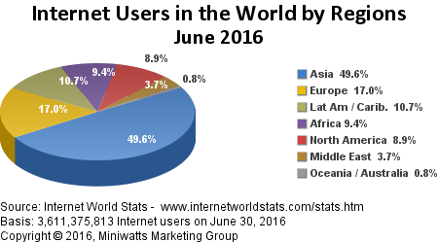
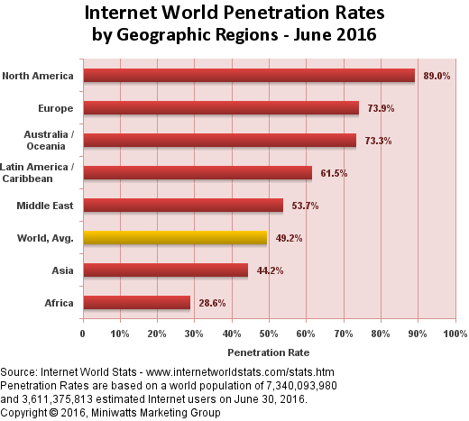
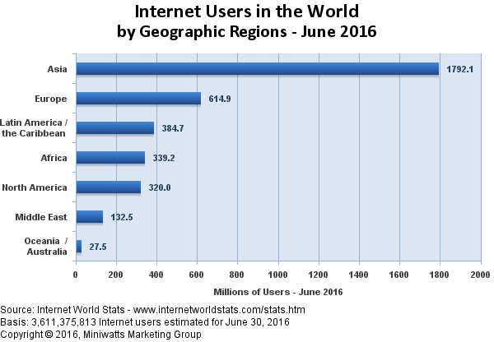
Africa Connectivity Facts

Slide 6
A Finding from these data
These Literacy facts + Internet facts => it’s very difficult to increase development at a basic level. People must take ownership of the National Development plans but most of them haven’t the keys to know and to apply or replicate what is thought for them by governments and what they have to do in this sense, because of NO or very LOW access to information and knowledge for development. (Gouvernmental information, Health information and knowledge, Economical information, Technical knowledge, Scientific Information and Scientific Knowledge, etc.)

Slide 7
AfLIA Strategic Plan 2015-2020
Supports this problem
http://dl.aflia.net/strategic_plan_2015_2020.pdf

Slide 8
Propositions in line with the strategic action highlighted (1)
African Librarians should be mediators and champions of "Development Literacy" by:
delivering relevant content in the most appropriate way (print documents accompanied by other services: discussions, forums, presentations, films…using local languages, not only official ones, to reach the illiterate audience) → Libraries as learning centres on Development
learning what is Development in the purpose of being able to teach it (as part of the public services they currently deliver). AfLIA should add such module in the INELI-SSAf curriculum, or build a training course (or workshop) on an annual basis titled: "Access to information & Knowledge Management for development" based on the UN2030 and AU2063 agendas (Format: Tot, or wide class). Partnership can be imagined with UNECA, through IDEP which is its training body (more than 50 years of experience). Continuing Capacity development & professional development

Slide 9
Propositions in line with the strategic action highlighted (2)
African Libraries should become the backbones of access to information and knowledge by:
providing digital content: developing mobile apps in addition to existing local digital libraries and repositories, achieving current projects (AVLIN/ASKIA) at a regional level
providing the best connectivity including WiFi and in a free way. Libraries in Africa should become Free Internet Zones, Free for ALL, not only for the Library subscribers. The charge would be supported by the local and national operators (through their Foundations), a kind of contribution to the development of countries where they earn benefits (governments should put in place more taxes for them, specially to fund this freedom of Internet in Libraries). Exception for Libraries in the Internet Business Model. Using Libraries (public and democratic places) as gateways to connect the next Billion.
adopting remote technologies that provide information and knowledge even with low or lack of Internet. Examples: Library Box developed by an american librarian inspired by the Pirate Box (music), Koombook developed by "Libraries without Borders" a French NGO with currently Pilot deployments in Cameroon, Côte d’Ivoire and Senegal. The Principle for both technologies: USB Key or a Box with content connected to an autonomous WiFi Router where people can connect themselves with appropriate devices: desktops, laptops, smartphones, tablets, etc.

Slide 10
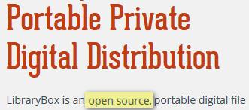
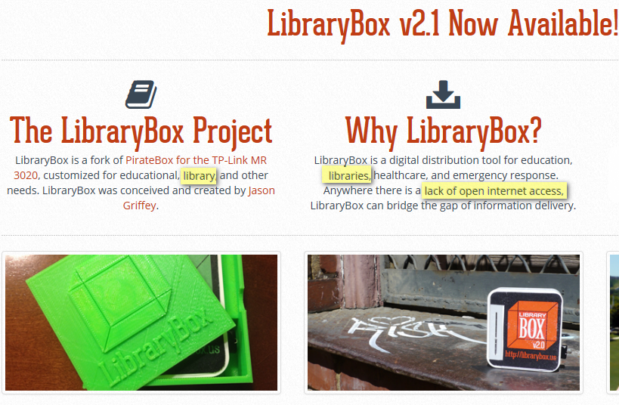
http://librarybox.us/

Slide 11
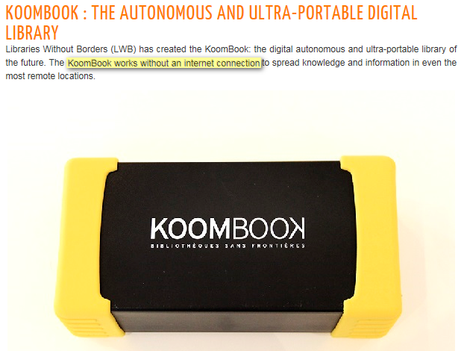
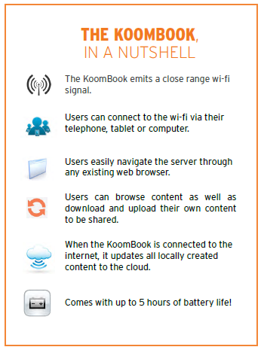
http://www.librarieswithoutborders.org/index.php/what-we-do/our-programs/abroad/transversal-programs/item/360-koombook-the-autonomous-and-ultra-portable-digital-library

Slide 12
Partnerships
AfLIA, by developing a dynamical yearbook of partners, can mobilize relevant resources to succeed on the issue of access to information and knowledge for Development.
National Library Associations
Library consortia
Governments
Private sector
NGOs & International Organizations: (e.g. African Library Project)
…

Slide 13
Trends that Create Opportunities For 21st Century Libraries
Trend
Opportunity
© 2015 Norman Jacknis, All Rights Reserved [http://njacknis.tumblr.com/post/131572189014/8-trends-create-8-opportunities-for-21st-century]
⇒To inspire African Libraries and Librarians

Slide 14
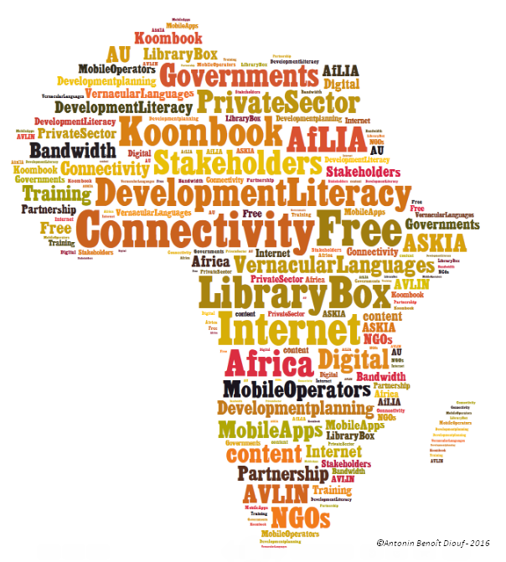
Keywords

Slide 15
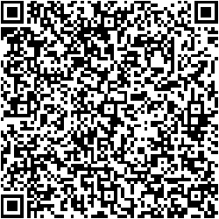
Thank you!
Social media: @tonnyben
http://antoninbenoitdiouf.com
AntoninBenoîtDIOUF

